Slide 1
Admin Suite

Slide 2
User Managment
What we will cover:
Accessing User Management
User Management Capabilities
How to reset password
How to create new user based on an existing user

Slide 3
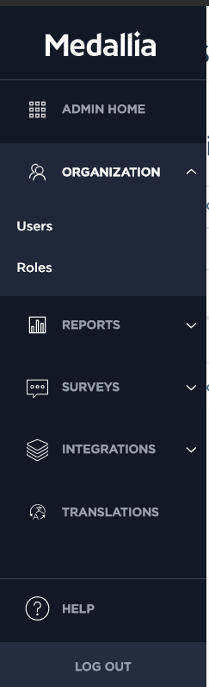
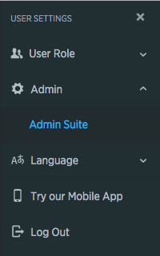
Accessing Admin Suite Users
From Reporting
Click on your name
Click Admin
Click Manage Users
From Admin Suite
Click Organization
Click Users

Slide 4
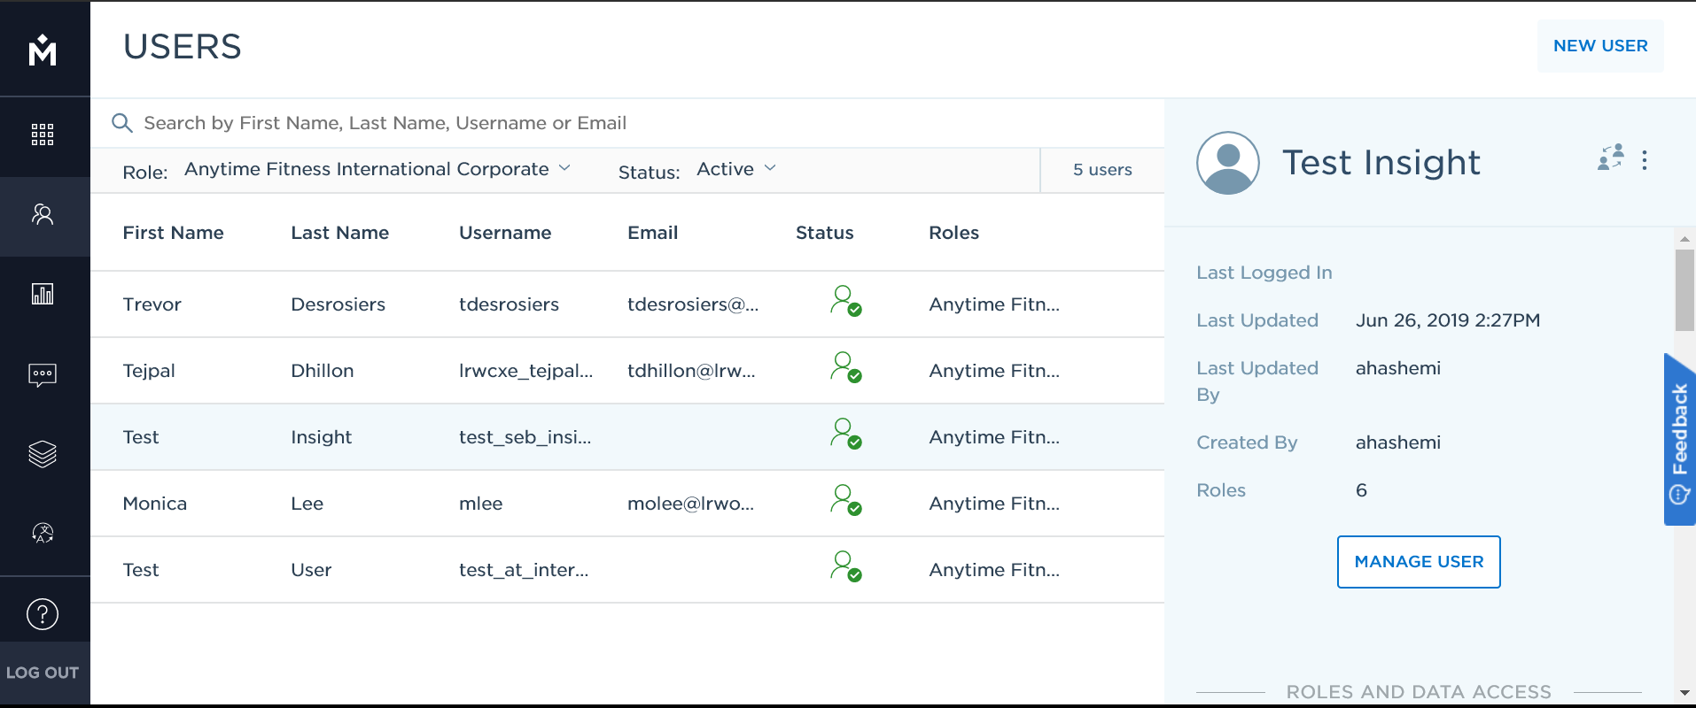
User Management Capabilites
Troubleshoot user access to get your employees back to work quickly
Create accounts to grant employees access without waiting for IT
Impersonate users for training and coaching
Access only users you have been given permission to

Slide 5
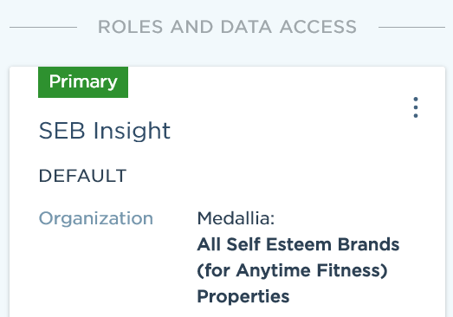
User Management Capabilities
Find users via filters and search
Create new user
Reset password or copy existing user
Impersonate user to verify changes are accurate
View Data access per role

Slide 6
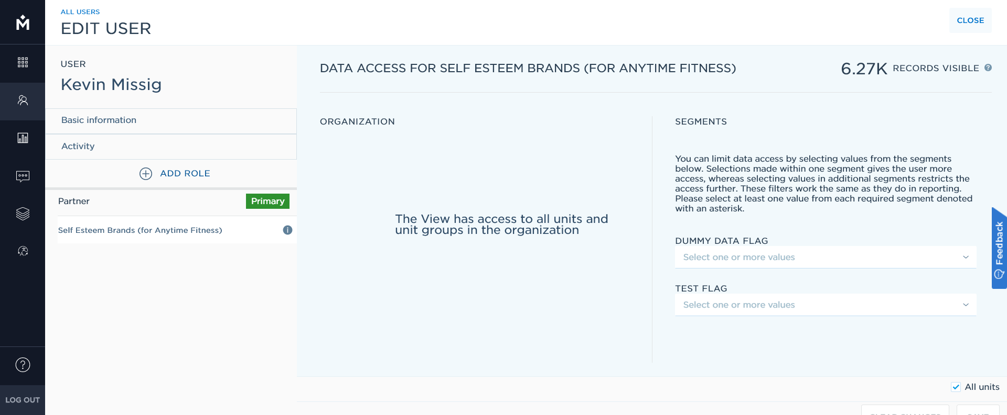
User Management Capabilities
Modify basic information about the user
Assign or remove roles from a user
Assign or remove data access for each view

Slide 7
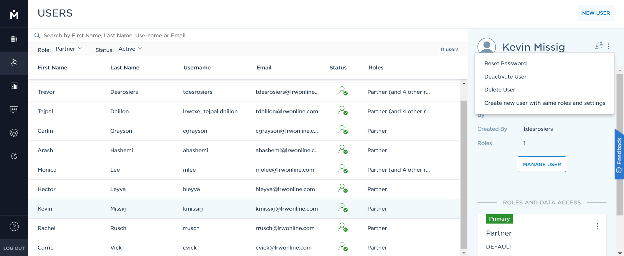
How to Reset a Password
2. Find and select user
3. Select 3 dots
4. Select “Reset Password”
1. Navigate to the Users list in Admin Suite

Slide 8
How to Create New User
2. Find and select user to copy based on
3. Select 3 dots
4. Select “Create new user with same roles and settings”
1. Navigate to the Users list in Admin Suite

Slide 9
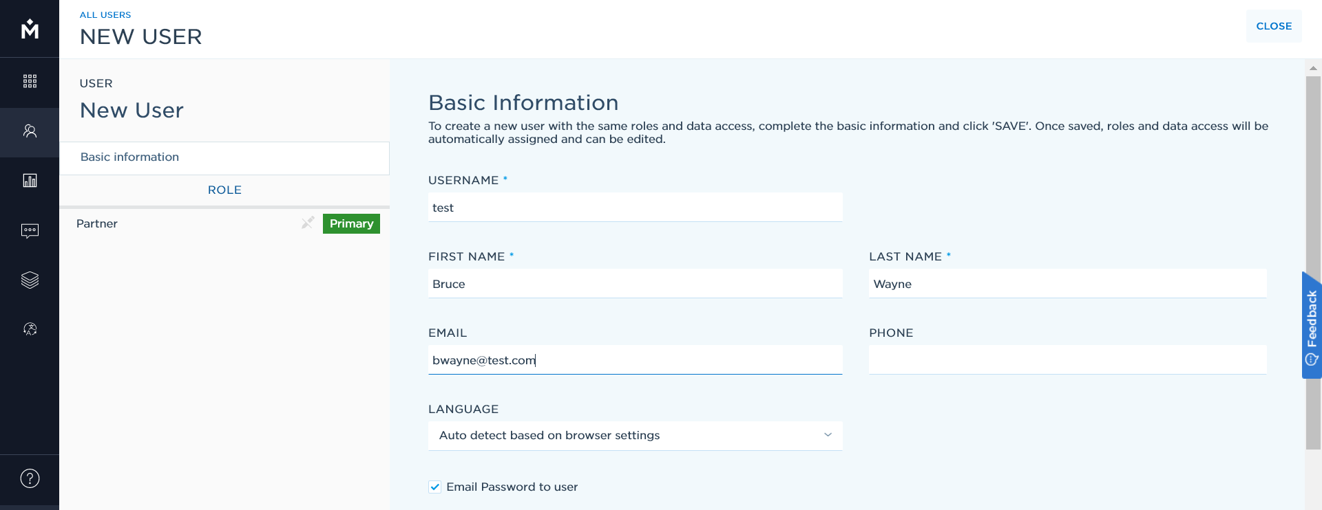
How to Create New User (continued)
Input basic information for new user: Username, First Name, Last Name, and email address
Welcome email will be sent from after the user is created.

